Slide 1
Drill Plan 21AUG18
Focus Areas
Orientation to Trophy Point
Sequence of Events
Command Voice
Key Leader Movement
Event: Ceremony Practice (Key Leader Drill)
Unit: BDE Key Leaders (BDE Staff and Ring Crest Rep / CPT Shed- Class OIC)
Location: Trophy Point
Uniform: Uniform of the day
Equipment: None
A/S3: Mark Company positions
Band: Request to use Trophy Point
WKDT: None
Support Staff: None
Inclement Weather: Ike Hall
Timeline:
1630: Assemble at Trophy Point
1635: Orientation to Trophy Point and Ceremony Entrance Routes
1650: Talk through Sequence of events
1700: Talk through Retreat and To the Colors
1705: Move to Ike Hall for Inclement Weather Ceremony Orientation
1715: Inclement Weather Talk Through

Slide 2
Drill Plan 23AUG18
Focus Areas
Sequence of Events
March Out
Unit Movement( Turns, Pace, COs commands)
Spacing between REGs, BNs, and COs
Maintaining pace when passing Reviewing Party
Staff Turns
Event: Full Dress Rehearsal (All 1CL and Ceremony Participants)
Unit: Full BDE
Location: Trophy Point
Uniform: Uniform of the day
Equipment: Guidons
A/S3: Oversee Set Up
Band: Yes, NLT 1615
WKDT: Yes, NLT 1615
Support Staff: Mark Company locations
Inclement Weather: N/A
Timeline:
1625: 1CL assembled on Apron
1640: 1CL Steps Off
1655: 1CL in place at Trophy Point and Rehearsal Begins
1700: Retreat and To the Colors
1800: Drill Complete

Slide 3
Drill Plan 24AUG18
Focus Areas
Sequence of Events
Event: Ring Ceremony (1CL and Ceremony Participants)
Unit: Full BDE
Location: Trophy Point
Uniform: India Whites and White Caps
Equipment: Guidons
A/S3: Oversee setup NLT 1530
Band: Yes, 1630hrs
WKDT: No
Support Staff: Set up Trophy Point
Inclement Weather: N/A
Timeline:
1615: 1CL Assembly and Accountability on Apron
1630: 1CL lined up on Apron
1640: 1CL Steps off
1655: Ceremony Begins
1745: Ceremony Complete

Slide 4
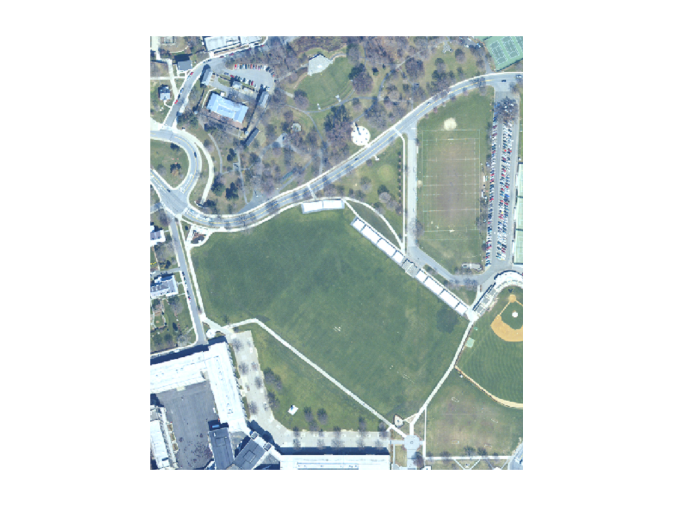
Ring Ceremony
Regimental Movement
TCP
TCP
TCP
THE PLAIN
4TH
3RD
2ND
1ST

Slide 5






Ceremony– Class Movement
Ring Party
RCRs & RTOs
1st CPT
30’
VIPs
D 4
C 4
B 4
A 4
TAC
D 1
C 1
B 1
A 1
13.5’
TAC
NCO
H 4
G 4
F 4
E 4
H 1
G 1
F 1
E 1
B 3
A 3
I 4
B 2
A 2
I 1
81’
E 3
D 3
C 3
E 2
D 2
C 2
G 3
F 3
G 2
F 2
3rd &
4th Regt
I 3
H 3
I 2
H 2
180’
STAIRS
1st & 2nd Regt

Slide 6

Company Formation
FRONT
A
CO CDR
TAC
RCR
Z
TAC NCO
Company formation is organized alphabetically by last name with the exception of the Company Commander and Ring and Crest Rep (RCR) Space determined
by actual class size per company

